Slide 1
4. Point Estimation

Slide 2
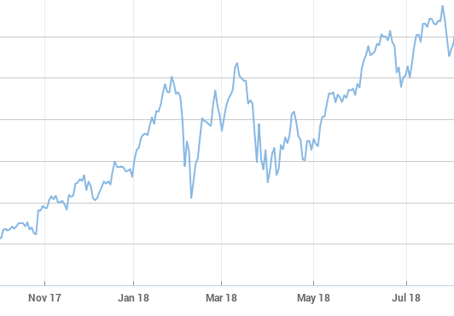
🌧
Poisson(λ)
Normal(μ, σ)
Alice PASS
Bob PASS
Charlie FAIL
Binomial(150, p)

Slide 3
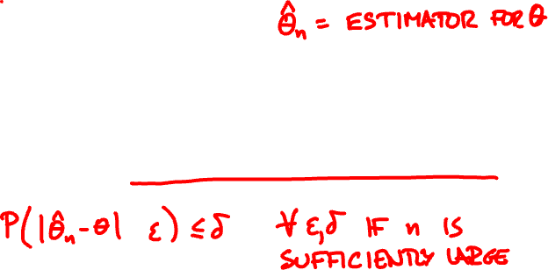
Estimators
X = (X₁, …, X_{n}) independent samples
^
Unbiased: E[Θ_{n}] = θ
^
Consistent: Θ_{n} converges to θ in probability

Slide 4


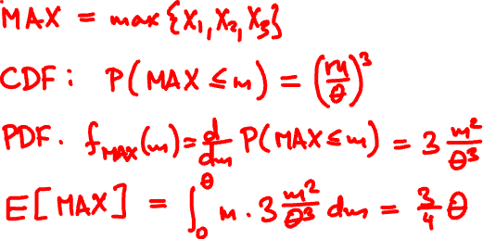
How to estimate θ from Uniform(0, θ) samples?

Slide 5
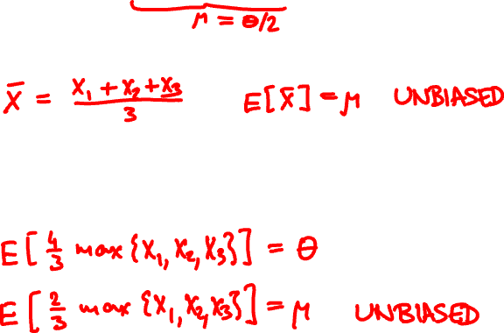
How to estimate E[Uniform(0, θ)] from 3 samples?
Option 1: sample mean
Option 2: via sample max

Slide 6

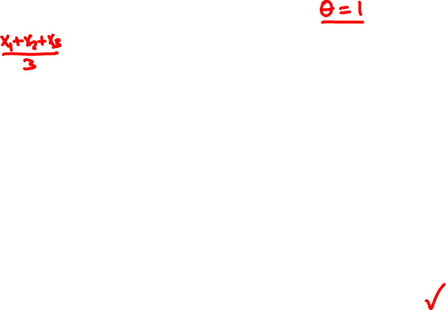
sample mean PDF
μ = 1/2
σ = 1/6
⅔ sample max PDF
μ = 1/2
σ ≈ 1/8

Slide 7

Minimum variance principle
Among unbiased estimators, it is preferable* to choose the one with smaller variance.

Slide 8
Maximum likelihood
maximize f_{X}(x | θ)
recall Bayesian MAP estimate:
maximize f_{Θ|X}(θ | x) ∝ f_{X|Θ}(x | θ) f_{Θ}(θ)

Slide 9
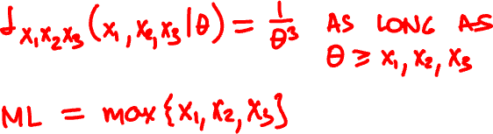
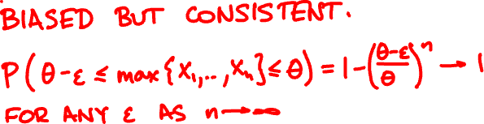
What is the ML for θ from Uniform(0, θ) samples?

Slide 10
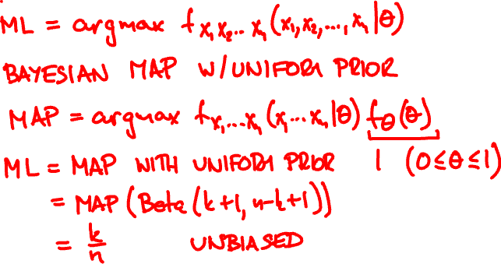
Maximum likelihood for Indicator(θ)
k heads, n – k tails. ML bias estimate?

Slide 11



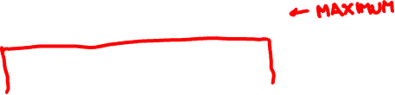
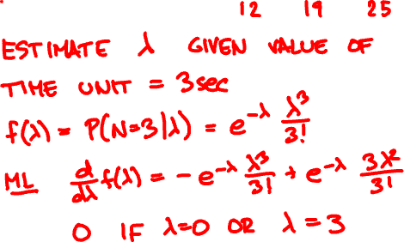
Within the first 3 seconds, raindrops arrive at times 1.2, 1.9, and 2.5. What is the estimated rate?
0
3

Slide 12


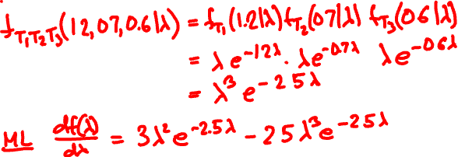
The first 3 raindrops arrive at 1.2, 1.9, and 2.5 sec. What is the estimated rate?
0

Slide 13

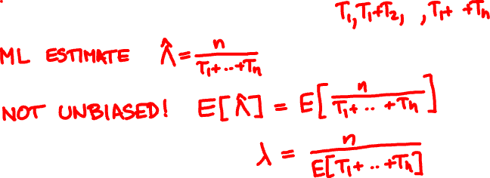

Maximum likelihood for Exponential(λ)

Slide 14
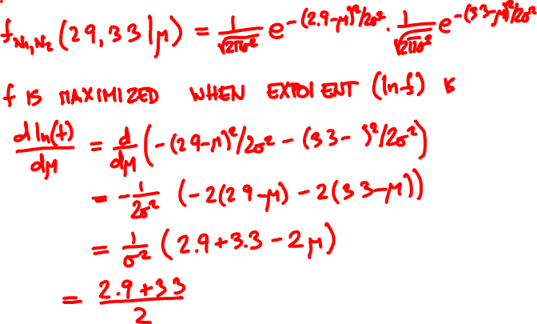
A Normal(μ, σ) RV takes values 2.9, 3.3. What is the ML estimate for μ?

Slide 15
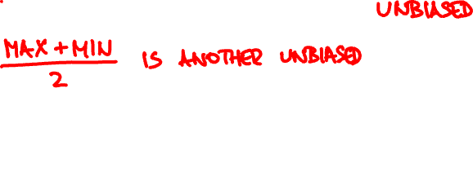
Maximum likelihood for Normal(μ, σ)
(X₁, …, X_{n}) independent Normal(μ, σ)
X₁ + … + X_{n}
ML estimate of μ:
X =
n
X is the Normal(μ, σ) estimator
of smallest possible variance.

Slide 16

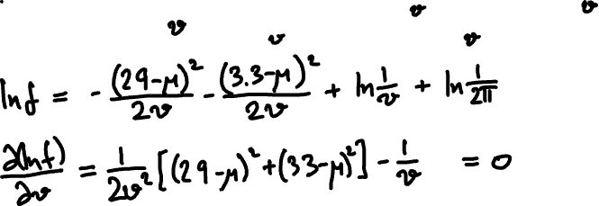

A Normal(μ, σ) RV takes values 2.9, 3.3. What is the ML estimate for v = σ²?

